Slide 1
<DATA STRUCTURES AND ALGORITHM>

Slide 2
VI. GRAPH

Slide 3
GRAPH
In the real world, many problems are represented in terms of objects and connections between them.
For example, in an airline route map, we might be interested in questions like: “What’s the fastest way to go from Kigali to New York?” or “What is the cheapest way to go from Kigali to New York?” To answer these questions we need information about connections (airline routes) between objects (towns). Graphs are data structures used for solving these kinds of problems.

Slide 4
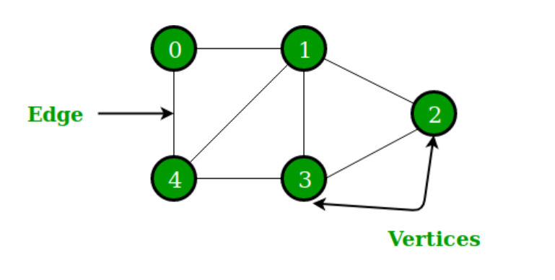
GRAPH
A Graph is a non-linear data structure consisting of nodes and edges. The nodes are sometimes also referred to as vertices and the edges are lines or arcs that connect any two nodes in the graph.

Slide 5
GRAPH
The set of vertices V = {0,1,2,3,4}
The set of edges E = {(0,1), (1,2), (2,3), (3,4), (0,4), (1,4), (1,3)}.

Slide 6
GRAPH
Graphs are used to solve many real-life problems. Graphs are used to represent networks. The networks may include paths in a city or telephone network or circuit network. Graphs are also used in social networks like linkedIn, Facebook. For example, in Facebook, each person is represented with a vertex(or node). Each node is a structure and contains information like person id, name, gender, locale etc.

Slide 7
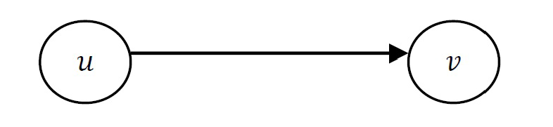
GRAPH DEFINITIONS
Directed edge:
Ordered pair of vertices (u, v)
First vertex u is the origin
Second vertex v is the destination
Example: one-way road traffic

Slide 8
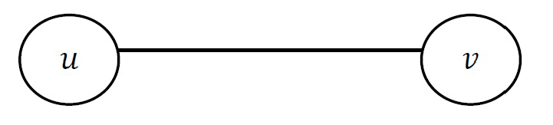
Undirected edge:
Unordered pair of vertices (u, v)
Example: railway lines

Slide 9
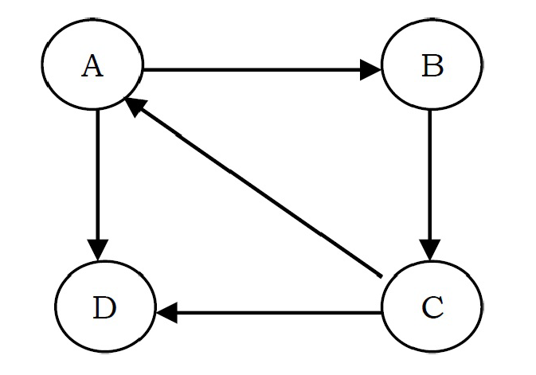
Directed graph:
All the edges are directed
Example: route network

Slide 10
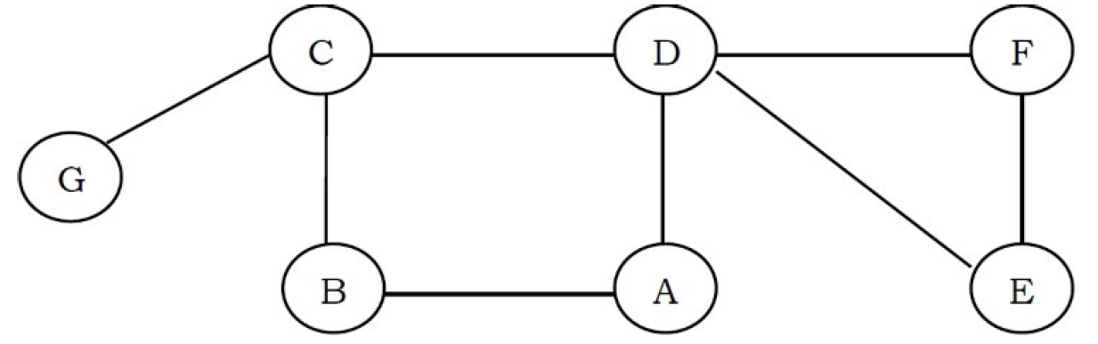
Undirected graph:
All the edges are undirected
Example: flight network

Slide 11
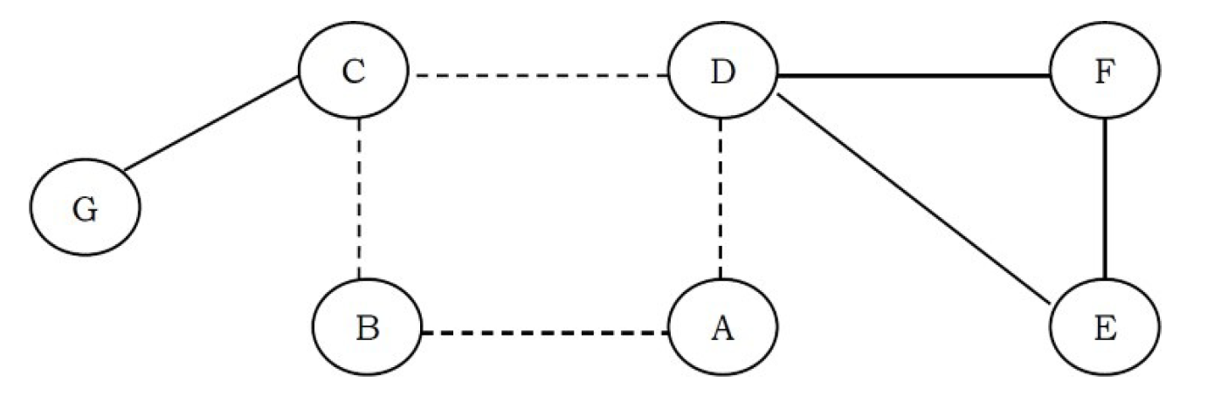
A cycle is a path where the first and last vertices are the same.

Slide 12
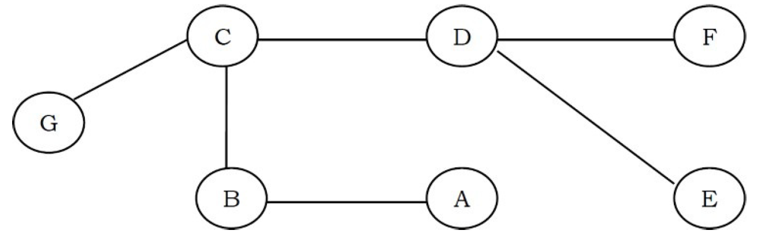
When an edge connects two vertices, the vertices are said to be adjacent to each other.
A graph with no cycles is called a tree. A tree is an acyclic connected graph.

Slide 13
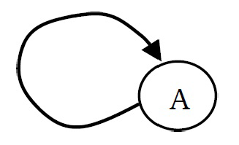
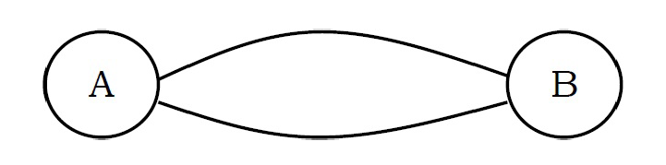
A self loop is an edge that connects a vertex to itself.
Two edges are parallel if they connect the same pair of vertices.

Slide 14
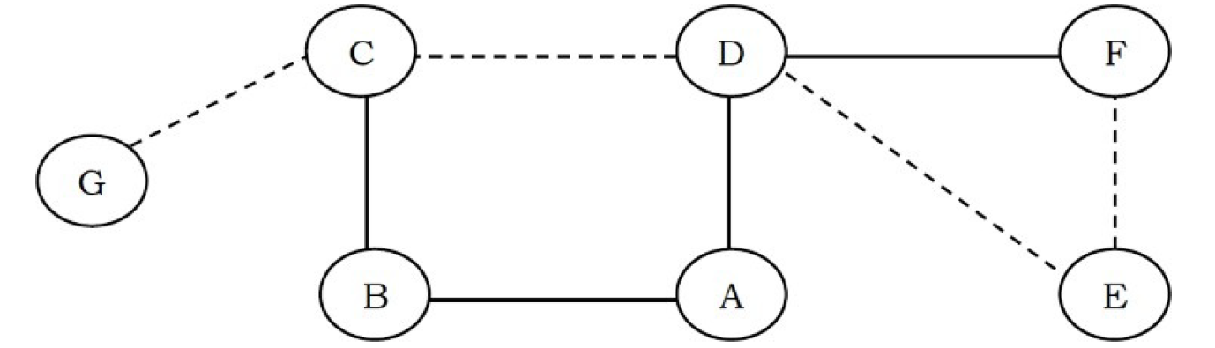
A path in a graph is a sequence of adjacent vertices. Simple path is a path with no repeated vertices. In the graph below, the dotted lines represent a path from G to E.
GCDE or GCDFE
We say that one vertex is connected to another if there is a path that contains both of them.

Slide 15
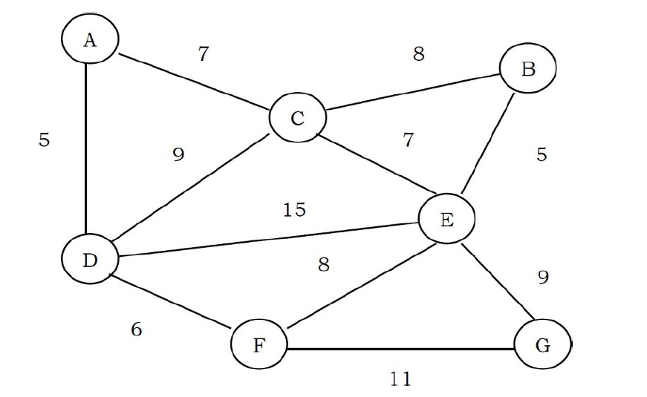
Weighted graphs integers (weights) are assigned to each edge to represent (distances or costs).

Slide 16
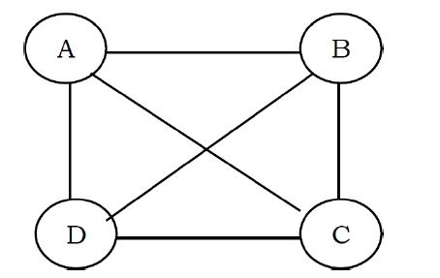
Graphs with all edges present are called complete graphs.

Slide 17
APPLICATIONS OF GRAPHS
Representing relationships between components in electronic circuits
Transportation networks: Highway network, Flight network
Computer networks: Local area network, Internet, Web(The networks may include paths in a city or telephone network or circuit network)
Databases: For representing ER (Entity Relationship) diagrams in databases, for representing dependency of tables in databases
Graphs are also used in social networks like linkedIn, Facebook. For example, in Facebook, each person is represented with a vertex(or node).

Slide 18
REFERENCES
Data Structures And Algorithms Made Easy: Data Structures And Algorithmic Puzzles by Narasimha Karumanchi
https://www.geeksforgeeks.org/

